Slide 1
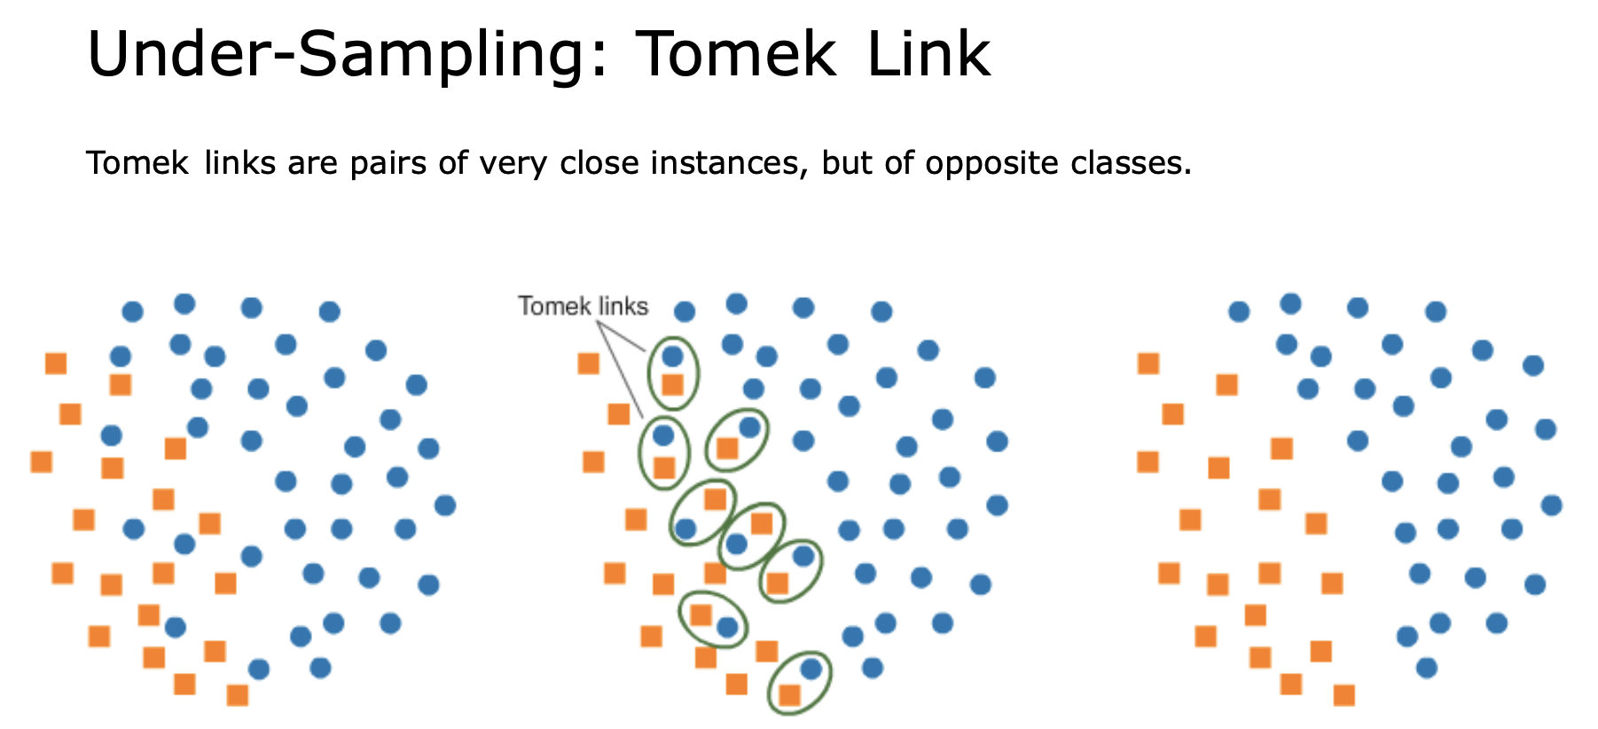
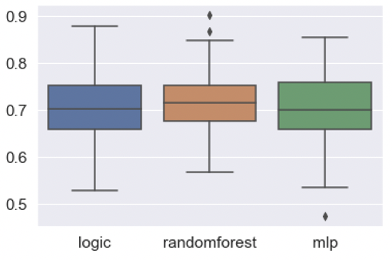
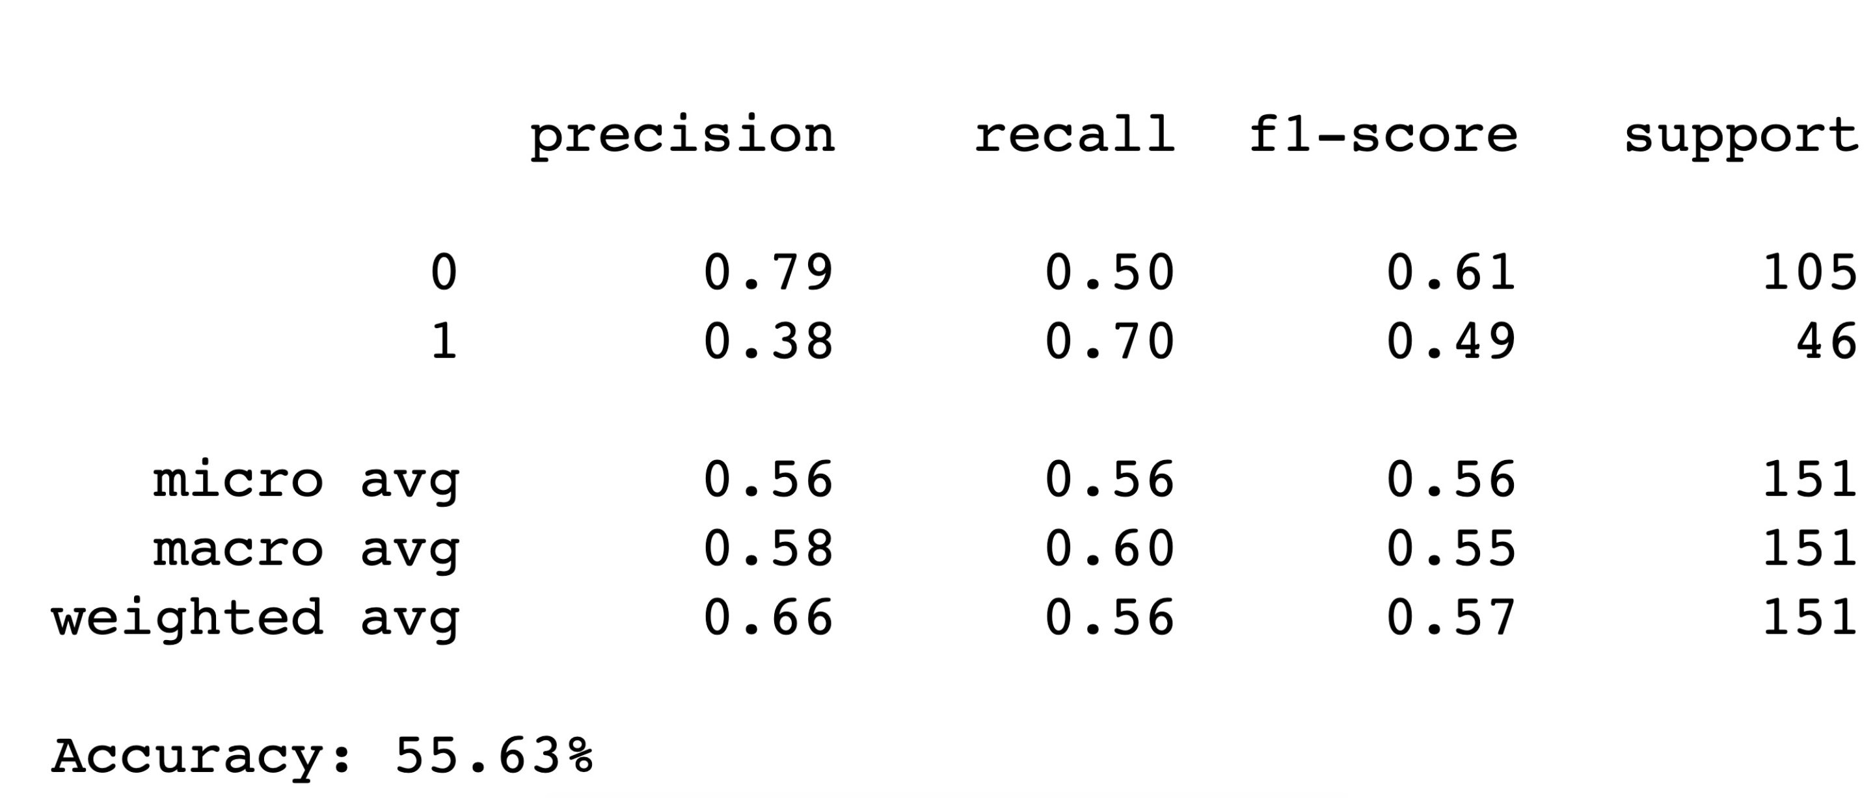
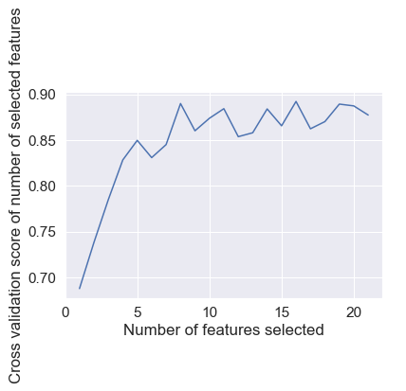
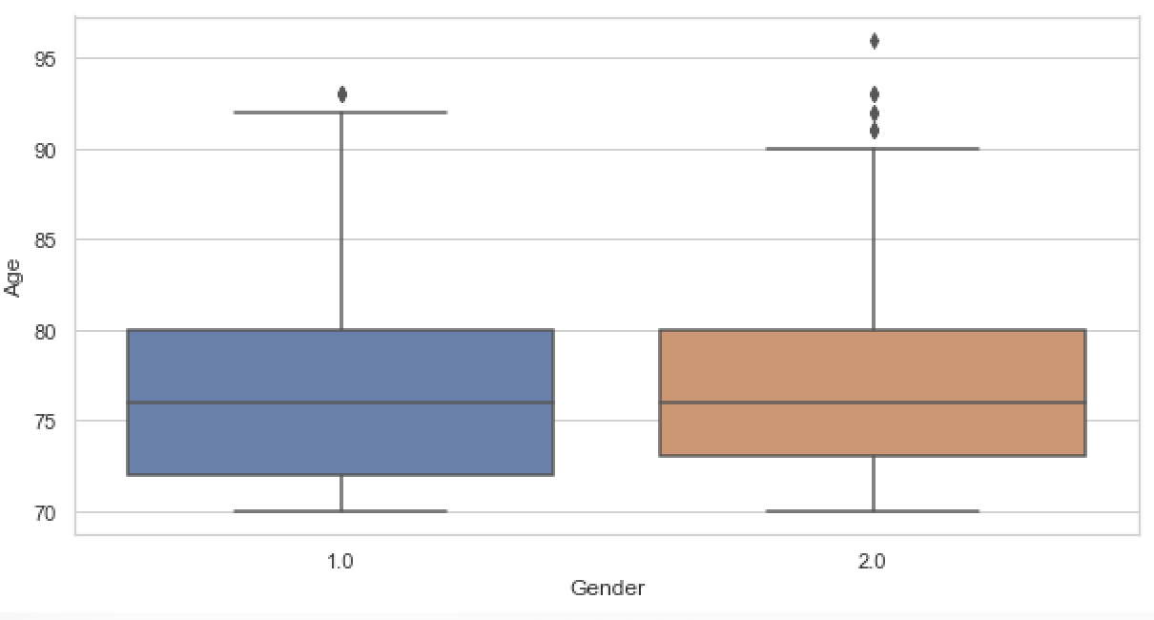
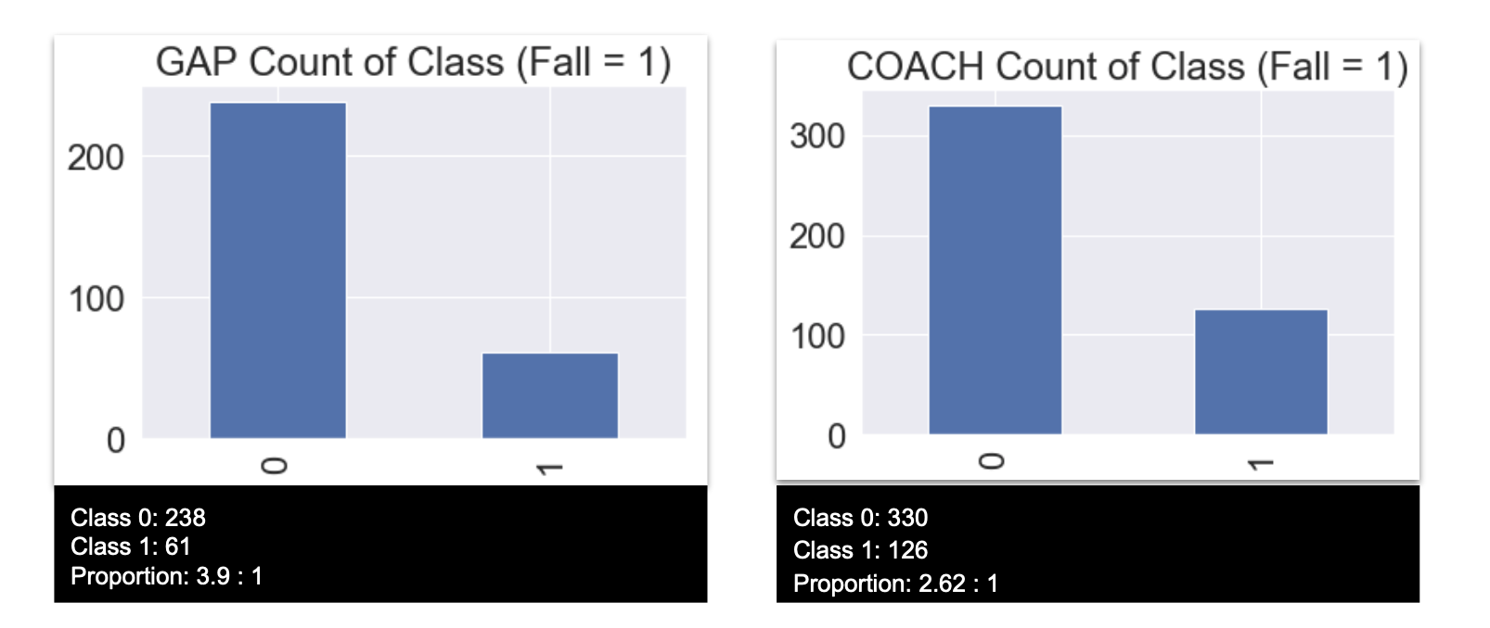
Machine Learning-Based Falling Rate Prediction
Model in Aging Cancer Patients
Boyu Liu¹, Sixu Meng¹, Junchao Shen¹, Zhikang Jiang¹
Sponsor: Erika Ramsdale², M.D., Mostafa Mohamed², M.D., M.Sc. Instructor: Ajay Anand¹, Ph.D. Xingyu Wang¹ (TA)
Goergen Institute of Data Science, University of Rochester
Department of Medicine/Oncology/Hemotology, University of Rochester Medical Center
1. Introduction
3. Feature Selection
Background: Falls are common, under-recognized events in the lives of older cancer adults, and are the leading cause of traumatic mortality in this patient group. [1] Almost one in three older adults fall each year,[2] and about 10% of these falls result in injuries, [3] including, fractures, traumatic brain injuries, internal bleeding and so on; Besides, falls are normally related to fear of falling, compromised physical performance, declined cognitive function. Therefore, we want to build a model that successfully predict the falling among the aging cancer population for both better diagnosis and prognosis.
Method: Major clinical features related to the falls, including IADL, SBBS, MiniCog, GDS were used to predict the falling in the cancer aging population. Machine learning algorithms like the random forest, logistic regression, neural network are used to train the model.
Result: Based on 755 Individuals recruited from the clinical trials, our model successfully validated the falling patients with a precision rate of 76% and patients not falling with a precision rate of 84%.
5. Results
6. Conclusion
To the best of our knowledge, this is the first study that used machine learning algorithms like random forest and MLP for predicting the falling rate among the aging cancer population. Meanwhile, our model performance is much better compared to most of the previous studies using other predictive models like regression model. Our study shows that machine learning has large predictive power and potential in future clinical study. Meanwhile, we would want to optimize the model by further improving its specificity in the future.
2. Data Collection
.
All participants (N = 755) were recruited from Wilmot Cancer Center and Highland Hospital by geriatric polypharmacy team. Patients needed to be over age 75 and diagnosed with certain types of cancers to be qualified for this study. Demographic information, financial and social status, and clinical data were collected for data analysis.
7. Acknowledgements
We thanked Amita Patil, Spencer Obrecht, M.S., along with the polypharmacy team from Wilmot Cancer Center for sponsoring and supporting us to finish this project.
4. Resampling Technique
8. References
1. CDC. Fatalities and Injuries from Falls Among Older Adults -- United States, 1993-2003 and 2001-2005. Morbidity and Mortality Weekly Report. 2006; 55(45):1221–4. [PubMed: 17108890]
2. Ganz DA, Bao Y, Shekelle PG, Rubenstein LZ. Will my patient fall? JAMA: The Journal of the American Medical Association. 2007; 297(1):77–86.
3. Tinetti ME, Williams CS. Falls, injuries due to falls, and the risk of admission to a nursing home. N Engl J Med. 1997; 337(18):1279–84. [PubMed: 9345078]

